Slide 1

Telecom Customers Churn Prediction

Slide 2
PROJECT NAME
Telecom Customers Churn Case
Team Name
Akash Prashant Mane
Anuja Berad
Ashish Jitendra Sawant
Deepika Kamlesh Tiwari
Gloria Daniel Dallu
Mayur Sudhir Chavhan
Vijay Durga Katar
Mentor-Saurabh Singh

Slide 3
Business Problem Statement
A Telecom company is losing Customers to its competitors. With the historical customer churn information that they have, they want a ML Model to predict, which of their present customers may churn.
Objectives:-
In the telecom industry, customers are able to choose from multiple service providers and actively switch from one operator to another. In this highly competitive market, the telecommunications industry experiences an average of 15-25% annual churn rate. Given the fact that it costs 5-10 times more to acquire a new customer than to retain an existing one, customer retention has now become even more important than customer acquisition.
For many incumbent operators, retaining high profitable customers is the number one business goal. To reduce customer churn, telecom companies need to predict which customers are at high risk of churn. In this project, we will analyse customer-level data of a leading telecom firm, build predictive models to identify customers at high risk of churn and identify the main indicators of churn.

Slide 4



Agenda for our Goal Achievement
Exploratory Data Analysis
Feature Engineering
Model Building
Model Evaluation
Model Deployment

Slide 5
Tools and Technical Parameters
Software
Libraries
Models
Deployment
Python
Jupiter
Pandas
Numpy
Seaborn
Scikit-learn
Imblearb
Logistic Regression
Random Forest
Decision
Tree
XGBoost
KNN
Streamlit

Slide 6

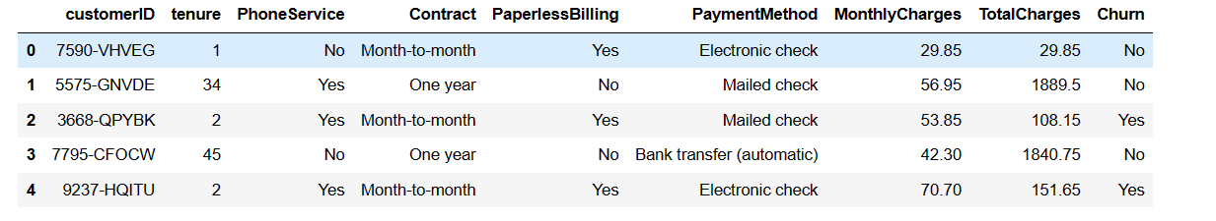
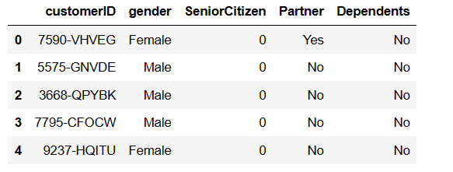
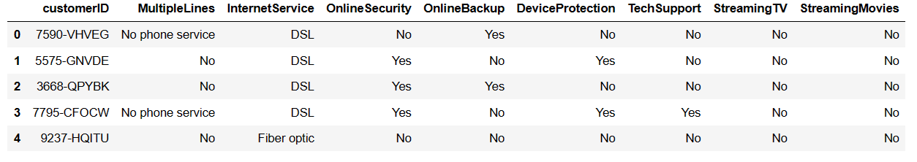
Data Set Details
Churn Data
Customer Data
Internet Data

Slide 7
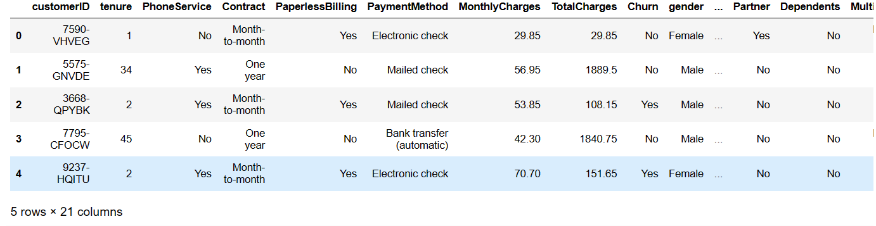
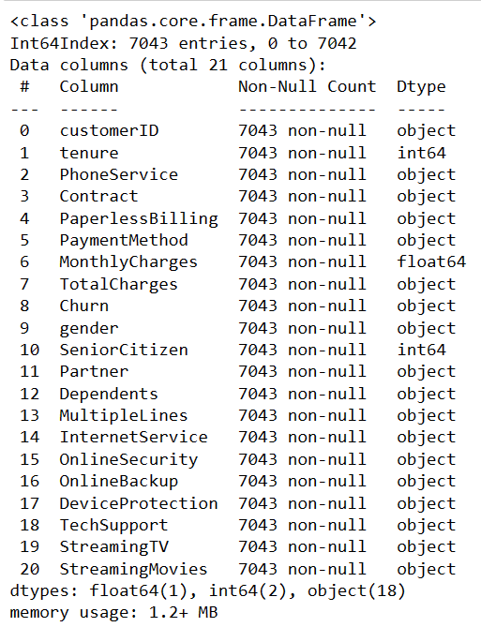
After Merged Data Set Details
Merged_telecom About Merged_telecom
Insight for After Merged Dataset:-
We have 7043 records and 21 features.
There are no any null value in the dataset.
In TotalCharges column having wrong datatype.
After Correcting the datatype We found there is null value
Preset in dataset.

Slide 8
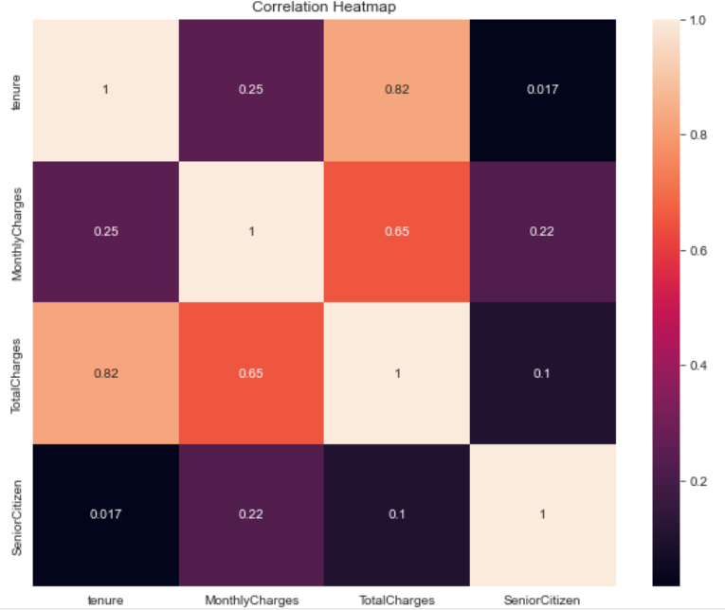
Exploratory Data Analysis
After the treat missing values from TotalChsrges
Features as there are 11 null values was presented.
Drop some unnecessary features like customerID
We can see here the TotalChareges and tenure columns are good ralation of 0.82 as well as MonthlyCharges and TotalCharges also have good relation of 0.65 but SeniorCitizen and tenure hasn't good ralation of 0.017. so in both columns needed to drop one column for the better accuracy of data. Now first of we checked our outlier detection by the visualization.

Slide 9
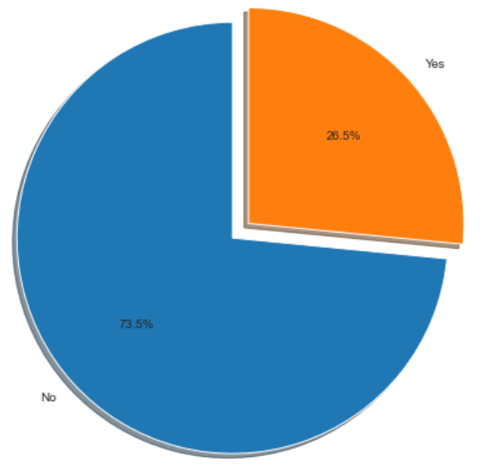
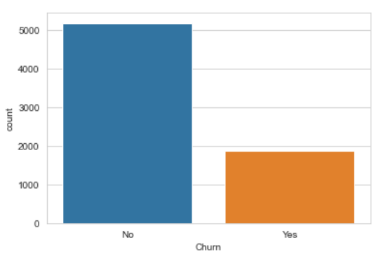
Data Imbalanced
After the analyzing the churn column, we have found that the only 26% of customers have churned and 73% customers have not churned let's see what is about next analyzing about the churn
After the count churned data here also found the huge different or we can say imbalanced the churn data so it's is necessary to balanced churn data for better accuracy of our model so let us used imbalanced technique .

Slide 10
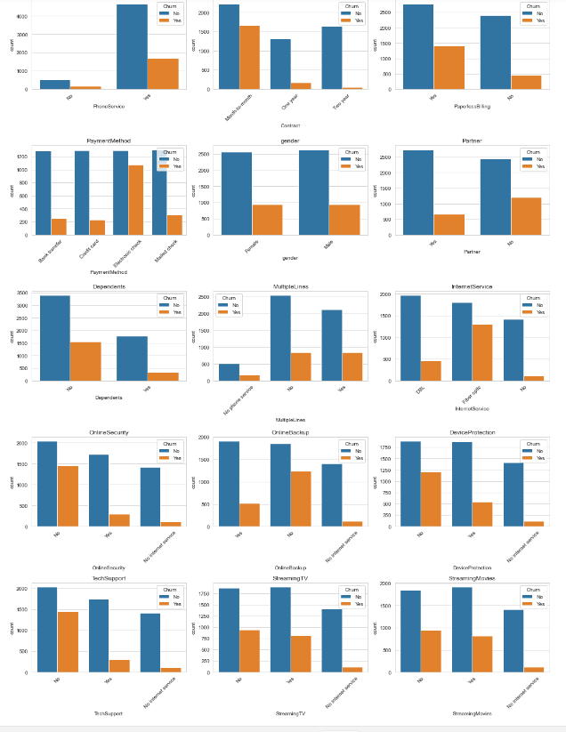
Data Visualization

Slide 11
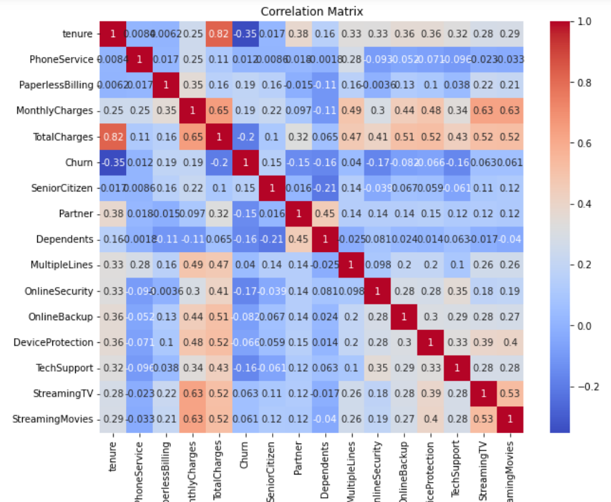
Feature Engineering
Based on correlation matrix after the EDA done vif, rfe, etc. Some of the input features were dropped.

Slide 12

Model Building Algorithms
Logistic Regression
Random forest
Decision Tree
KNN
XGBoost
SVM
All the above we are used to find out best model
For churn prediction. And model have been modified to correct data imbalanced via techniques like SMOTE, stratified sampling, UnderSamplin and OverSampling.

Slide 13
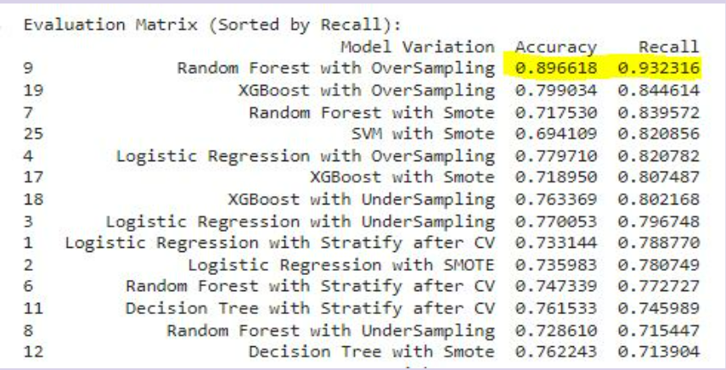
Model Evaluation and Select Model
Customer retention being the primary criteria, minimizing the false negatives is crucial, meaning reducing the prediction where a customer is identified as not churned when they actually churned. Recall has therefore been identified as the main metric.

Slide 14
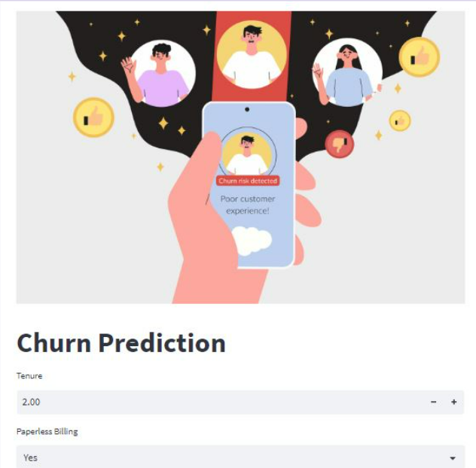
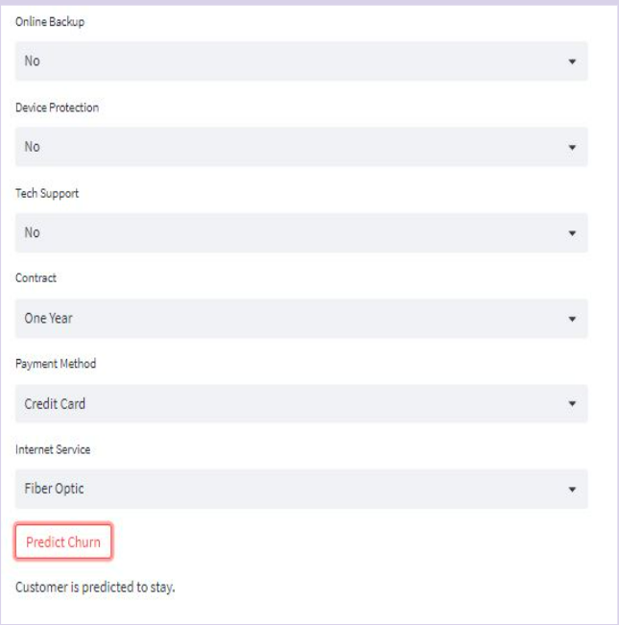
Model Deployment

Slide 15
Challenges and difficulties faced
Data Preprocessing: Telecom datasets often contain a large volume of data, including structured and unstructured data. Cleaning, transforming, and integrating diverse data sources can be time-consuming and complex. Missing values, inconsistent data formats, and data inconsistencies need to be addressed to ensure the accuracy and reliability of the analysis.
Imbalanced Data: Churn datasets typically suffer from class imbalance, where the number of churned customers is significantly lower than non-churned customers. This can affect the performance of predictive models, leading to biased results.
Feature Engineering: Identifying relevant features from the available data is critical for building accurate churn prediction models.
Model Selection and Evaluation: Choosing the appropriate machine learning algorithms or models is crucial for accurate churn prediction. Different models, such as logistic regression, decision trees, random forests, have their own strengths and weaknesses. Evaluating and comparing the performance of various models can be challenging
Deployment: Successfully implementing churn prediction models in a telecom environment requires overcoming deployment challenges. It’s so difficult to do

Slide 16
Conclusion
After conducting a thorough analysis of various models and applying different sampling techniques, it was determined that the Random Forest model with oversampling achieved the highest recall and accuracy for churn prediction.
The churn prediction analysis provides valuable insights for businesses. By leveraging the identified factors, organizations can make informed decisions to proactively retain customers. For example, offering personalized incentives or promotions based on contract type or payment preferences to help enhance customer satisfaction and loyalty.
Churn prediction is an ongoing process that requires continuous improvement and adaptation. As customer preferences and market dynamics evolve, it's essential to regularly update and refine the models to ensure their accuracy and relevance.

Slide 17

Thank You

